Slide 1
Opioid Intervention Court
Cumberland County, Pennsylvania

Slide 2
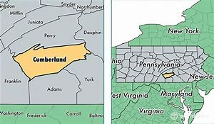

Slide 3
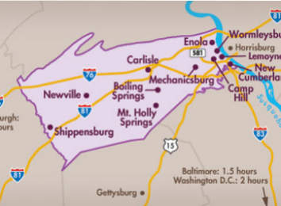

Slide 4
The Problem
In 2016, 13 Pennsylvanians died daily due to opioids
The epidemic is the leading cause of death for people under age 50
Between 2015-2016, most counties saw a 37% increase in deaths related to drug poisoning
Cumberland County saw a 61% increase in fatalities in that time period

Slide 5
The Problem
Between 2011 and 2015, there was a 200% increase in the number of inmates placed on medical detox from opiates upon commitment to CCP
The Sentinel identified individuals with recent criminal charges made up nearly 60% of all overdose deaths in the county in 2015
These same individuals were 110 times more likely to die of an overdose that year than those without recent charges

Slide 6
The Problem
Cumberland County experienced a 25% increase in criminal dockets filed between 2015 and 2017 (+1000 cases)
The average daily population at the Cumberland County Prison increased from 400 to 460 during the same time period.

Slide 7
A Response
Administrative Office of Pennsylvania Courts (AOPC) approached Cumberland County to start an opioid court based on the Buffalo model.
Funding
$200K from AOPC
$150K from PA Commission on Crime & Delinquency

Slide 8
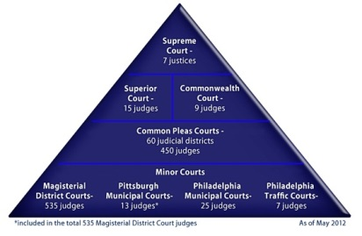
Court Structure

Slide 9
Arrest
Preliminary Arraignment
Magisterial
District
Justice
Jail
Bail
Summons
Preliminary Hearing
Formal Arraignment
Court of
Common
Pleas
Pretrial Conference
Trial

Slide 10
Opioid Intervention Court
Started February 26, 2018
Team
Judge
Coordinator
Assistant District Attorney
Public Defender
Program Manager
Drug & Alcohol Case Manager – Jail
3 Certified Recovery Specialists
2 Restorative Sanctions Assistants
2 Adult Probation & Parole Officers

Slide 11
The Process
LEOs and MDJs identify defendants based on charges or other information
MDJ sets OIC screening bail condition
Jail: review booking documents, and/or review detox list
Bail: report to OIC next business day
Summons: report to Public Defender next Wednesday at 1:30 pm

Slide 12
Screening - Community
Acknowledgement form
Outlines basic conditions of program
Select to pursue OIC with PD or private attorney
Select to decline OIC
Texas Christian University (TCU) Drug Screen 5
Opioid Supplement
Personal Information Form
Urine Drug Screen

Slide 13
Screening - Community
Observe OIC
Bail modification hearing

Slide 14
Screening - Jail
Acknowledgement Form
TCU 5 w/Opioid Supplement
Personal Information Form
Develop treatment plan
Vivitrol program, drug and alcohol evaluation
Develop approved home plan
Resolve warrant and detainers
Video bail modification hearing

Slide 15
Program Eligibility
Pre-plea
Adult defendant with pending misdemeanor or felony charge(s)
Cumberland County resident
Some minor exceptions
Substantiated opioid substance-use disorder
District Attorney has veto authority
Generally drug dealer or felony crime of violence

Slide 16
The Program
30 days consecutive court appearances
Frequent drug testing
Daily treatment/recovery activity
Treatment LOC, self-help group meeting, RASE recovery group 1x week, other counseling
Engaged in RASE recovery plan
Nightly curfew 8:00 pm – 8:00 am
Monitored with BI SmartLink phone app

Slide 17
The Program
Daily routine
8:00 am: defendants report to Restorative Sanctions in courthouse basement to sign in and drug test if selected
8:45 am: drug testing wraps up and team meets for mini-staffing prior to court
9:00 am (-ish): court begins and each defendant goes before judge
Team staffing is Monday following court

Slide 18
The Program
Defendants awarded completion certificate at end of active phase
Step down to continuing care phase until case disposition
Appear 1 x weekly
Continue treatment level of care
Continue self-help group meetings
Continue RASE recovery plan

Slide 19
The Program
Case disposition goals
Have offer ready and enter guilty plea at completion of active phase
Set sentencing date for a sufficient period of continuing care
Defendants who successfully complete active and continuing care phases see significant reduction in sentencing

Slide 20
Stuff Happens
Sanctions
Opioid use: jail, revocation
Other drug use: recovery assignment, days added, house arrest/EM, jail, revocation
Other violations: recovery assignment, days added, sit in penalty box, increase appearances, jail, revocation
New offense/abscond: jail, revocation

Slide 21
The Results
Admitted…………………….93
Active………………………...12
Continuing Care………….12
Jail/Treatment………………0
Bench Warrant……………..1
Successful…………………..38
Revoked – Active………..14
Revoked – Continuing Care……………………………14
Other disposition………….2
In-program re-offending………………….4
Post-program re-offending……………….…1
Pipelined to Treatment Court………………………….12
Pipelined to TOMS Court……………………………2
Deaths………………………….0

Slide 22
The Results

Slide 23
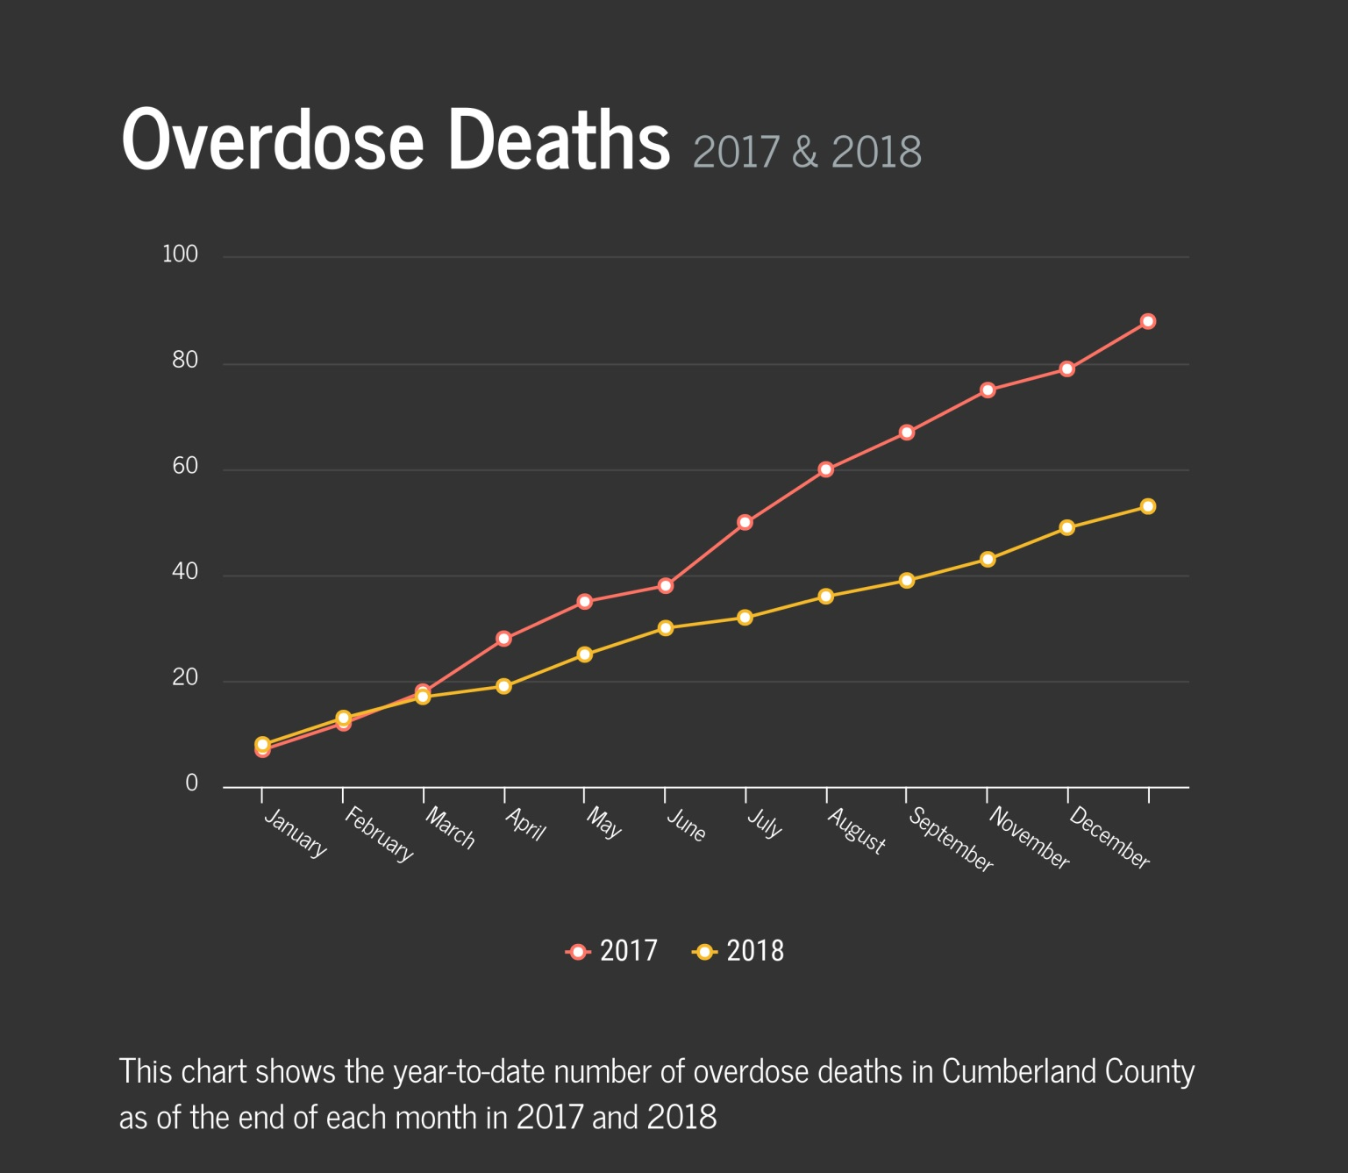
The Results

